Slide 1
Object-Oriented Software Engineering
Practical Software Development using UML and Java
Chapter 9:
Architecting and Designing Software

Slide 2
9.1 The Process of Design
Definition:
  Design is a problem-solving process whose objective is to find and describe a way:
    To implement the system’s functional requirements...
    While respecting the constraints imposed by the quality, platform and process requirements...
      including the budget
    And while adhering to general principles of good quality

Slide 3
Design as a series of decisions
A designer is faced with a series of design issues
  These are sub-problems of the overall design problem.
  Each issue normally has several alternative solutions:
    design options.
  The designer makes a design decision to resolve each issue.
    This process involves choosing the best option from among the alternatives.

Slide 4
Making decisions
To make each design decision, the software engineer uses:
  Knowledge of
    the requirements
    the design as created so far
    the technology available
    software design principles and ‘best practices’
    what has worked well in the past

Slide 5
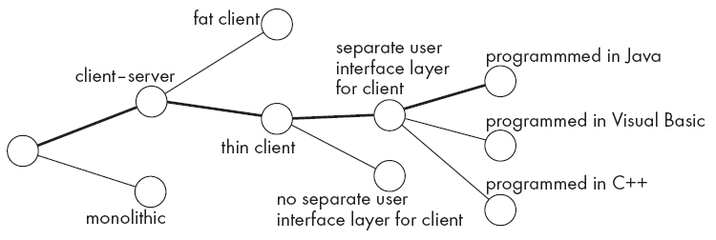
Design space
The space of possible designs that could be achieved by choosing different sets of alternatives is often called the design space
  For example:

Slide 6
Component
Any piece of software or hardware that has a clear role.
  A component can be isolated, allowing you to replace it with a different component that has equivalent functionality.
  Many components are designed to be reusable.
  Conversely, others perform special-purpose functions.

Slide 7
Module
A component that is defined at the programming language level
  For example, methods, classes and packages are modules in Java.

Slide 8
System
A logical entity, having a set of definable responsibilities or objectives, and consisting of hardware, software or both.
  A system can have a specification which is then implemented by a collection of components.
  A system continues to exist, even if its components are changed or replaced.
  The goal of requirements analysis is to determine the responsibilities of a system.
  Subsystem:
    A system that is part of a larger system, and which has a definite interface

Slide 9
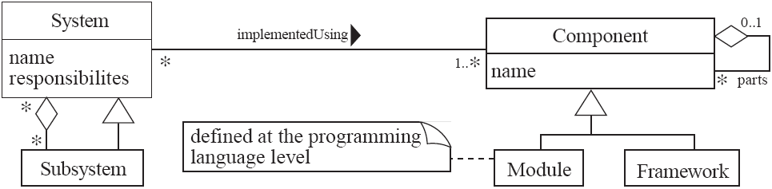
UML diagram of system parts

Slide 10
Top-down and bottom-up design
Top-down design
  First design the very high level structure of the system.
  Then gradually work down to detailed decisions about low-level constructs.
  Finally arrive at detailed decisions such as:
    the format of particular data items;
    the individual algorithms that will be used.

Slide 11
Top-down and bottom-up design
Bottom-up design
  Make decisions about reusable low-level utilities.
  Then decide how these will be put together to create high-level constructs.
A mix of top-down and bottom-up approaches are normally used:
  Top-down design is almost always needed to give the system a good structure.
  Bottom-up design is normally useful so that reusable components can be created.

Slide 12
Different aspects of design
  Architecture design:
    The division into subsystems and components,
      How these will be connected.
      How they will interact.
      Their interfaces.
  Class design:
    The various features of classes.
  User interface design
  Algorithm design:
    The design of computational mechanisms.
  Protocol design:
    The design of communications protocol.

Slide 13
9.2 Principles Leading to Good Design
Overall goals of good design:
  Increasing profit by reducing cost and increasing revenue
  Ensuring that we actually conform with the requirements
  Accelerating development
  Increasing qualities such as
    Usability
    Efficiency
    Reliability
    Maintainability
    Reusability

Slide 14
Design Principle 1: Divide and conquer
Trying to deal with something big all at once is normally much harder than dealing with a series of smaller things
  Separate people can work on each part.
  An individual software engineer can specialize.
  Each individual component is smaller, and therefore easier to understand.
  Parts can be replaced or changed without having to replace or extensively change other parts.

Slide 15
Ways of dividing a software system
  A distributed system is divided up into clients and servers
  A system is divided up into subsystems
  A subsystem can be divided up into one or more packages
  A package is divided up into classes
  A class is divided up into methods

Slide 16
Design Principle 2: Increase cohesion where possible
A subsystem or module has high cohesion if it keeps together things that are related to each other, and keeps out other things
  This makes the system as a whole easier to understand and change
  Type of cohesion:
    Functional, Layer, Communicational, Sequential, Procedural, Temporal, Utility

Slide 17
Functional cohesion
This is achieved when all the code that computes a particular result is kept together - and everything else is kept out
  i.e. when a module only performs a single computation, and returns a result, without having side-effects.
  Benefits to the system:
    Easier to understand
    More reusable
    Easier to replace
  Modules that update a database, create a new file or interact with the user are not functionally cohesive

Slide 18
Layer cohesion
All the facilities for providing or accessing a set of related services are kept together, and everything else is kept out
  The layers should form a hierarchy
    Higher layers can access services of lower layers,
    Lower layers do not access higher layers
  The set of procedures through which a layer provides its services is the application programming interface (API)
  You can replace a layer without having any impact on the other layers
    You just replicate the API

Slide 19
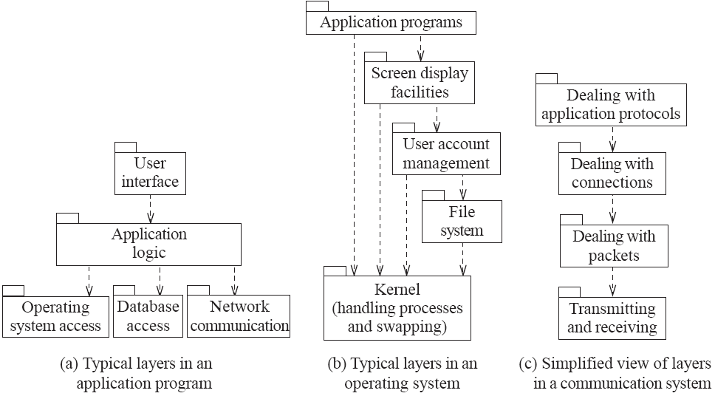
Example of the use of layers

Slide 20
Communicational cohesion
All the modules that access or manipulate certain data are kept together (e.g. in the same class) - and everything else is kept out
  A class would have good communicational cohesion
    if all the system’s facilities for storing and manipulating its data are contained in this class.
    if the class does not do anything other than manage its data.
  Main advantage: When you need to make changes to the data, you find all the code in one place

Slide 21
Sequential cohesion
Procedures, in which one procedure provides input to the next, are kept together – and everything else is kept out
  You should achieve sequential cohesion, only once you have already achieved the preceding types of cohesion.

Slide 22
Procedural cohesion
Procedures that are used one after another are kept together
  Even if one does not necessarily provide input to the next.
  Weaker than sequential cohesion.

Slide 23
Temporal Cohesion
Operations that are performed during the same phase of the execution of the program are kept together, and everything else is kept out
  For example, placing together the code used during system start-up or initialization.
  Weaker than procedural cohesion.

Slide 24
Utility cohesion
When related utilities which cannot be logically placed in other cohesive units are kept together
  A utility is a procedure or class that has wide applicability to many different subsystems and is designed to be reusable.
  For example, the java.lang.Math class.

Slide 25
Design Principle 3: Reduce coupling where possible
Coupling occurs when there are interdependencies between one module and another
  When interdependencies exist, changes in one place will require changes somewhere else.
  A network of interdependencies makes it hard to see at a glance how some component works.
  Type of coupling:
    Content, Common, Control, Stamp, Data, Routine Call, Type use, Inclusion/Import, External

Slide 26
Content coupling:
Occurs when one component surreptitiously modifies data that is internal to another component
  To reduce content coupling you should therefore encapsulate all instance variables
    declare them private
    and provide get and set methods
  A worse form of content coupling occurs when you directly modify an instance variable of an instance variable

Slide 27
Example of content coupling
public class Line
{
private Point start, end;
...
public Point getStart() { return start; }
public Point getEnd() { return end; }
}
public class Arch
{
private Line baseline;
...
void slant(int newY)
{
Point theEnd = baseline.getEnd();
theEnd.setLocation(theEnd.getX(),newY);
}
}

Slide 28
Common coupling
Occurs whenever you use a global variable
  All the components using the global variable become coupled to each other
  A weaker form of common coupling is when a variable can be accessed by a subset of the system’s classes
    e.g. a Java package
  Can be acceptable for creating global variables that represent system-wide default values
  The Singleton pattern provides encapsulated global access to an object

Slide 29
Control coupling
Occurs when one procedure calls another using a ‘flag’ or ‘command’ that explicitly controls what the second procedure does
  To make a change you have to change both the calling and called method
  The use of polymorphic operations is normally the best way to avoid control coupling
  One way to reduce the control coupling could be to have a look-up table
    commands are then mapped to a method that should be called when that command is issued

Slide 30
Example of control coupling
public routineX(String command)
{
if (command.equals("drawCircle")
{
drawCircle();
}
else
{
drawRectangle();
}
}

Slide 31
Stamp coupling:
Occurs whenever one of your application classes is declared as the type of a method argument
  Since one class now uses the other, changing the system becomes harder
    Reusing one class requires reusing the other
  Two ways to reduce stamp coupling,
    using an interface as the argument type
    passing simple variables

Slide 32
Example of stamp coupling
public class Emailer
{
public void sendEmail(Employee e, String text)
{...}
...
}
Using simple data types to avoid it:
public class Emailer
{
public void sendEmail(String name, String email, String text)
{...}
...
}

Slide 33
Example of stamp coupling
Using an interface to avoid it:
public interface Addressee
{
public abstract String getName();
public abstract String getEmail();
}
public class Employee implements Addressee {…}
public class Emailer
{
public void sendEmail(Addressee e, String text)
{...}
...
}

Slide 34
Data coupling
Occurs whenever the types of method arguments are either primitive or else simple library classes
  The more arguments a method has, the higher the coupling
    All methods that use the method must pass all the arguments
  You should reduce coupling by not giving methods unnecessary arguments
  There is a trade-off between data coupling and stamp coupling
    Increasing one often decreases the other

Slide 35
Routine call coupling
Occurs when one routine (or method in an object oriented system) calls another
  The routines are coupled because they depend on each other’s behaviour
  Routine call coupling is always present in any system.
  If you repetitively use a sequence of two or more methods to compute something
    then you can reduce routine call coupling by writing a single routine that encapsulates the sequence.

Slide 36
Type use coupling
Occurs when a module uses a data type defined in another module
  It occurs any time a class declares an instance variable or a local variable as having another class for its type.
  The consequence of type use coupling is that if the type definition changes, then the users of the type may have to change
  Always declare the type of a variable to be the most general possible class or interface that contains the required operations

Slide 37
Inclusion or import coupling
Occurs when one component imports a package
  (as in Java)
or when one component includes another
  (as in C++).
  The including or importing component is now exposed to everything in the included or imported component.
  If the included/imported component changes something or adds something.
    This may raises a conflict with something in the includer, forcing the includer to change.
  An item in an imported component might have the same name as something you have already defined.

Slide 38
External coupling
When a module has a dependency on such things as the operating system, shared libraries or the hardware
  It is best to reduce the number of places in the code where such dependencies exist.
  The Façade design pattern can reduce external coupling

Slide 39
Design Principle 4: Keep the level of abstraction as high as possible
Ensure that your designs allow you to hide or defer consideration of details, thus reducing complexity
  A good abstraction is said to provide information hiding
  Abstractions allow you to understand the essence of a subsystem without having to know unnecessary details

Slide 40
Abstraction and classes
Classes are data abstractions that contain procedural abstractions
  Abstraction is increased by defining all variables as private.
  The fewer public methods in a class, the better the abstraction
  Superclasses and interfaces increase the level of abstraction
  Attributes and associations are also data abstractions.
  Methods are procedural abstractions
    Better abstractions are achieved by giving methods fewer parameters

Slide 41
Design Principle 5: Increase reusability where possible
Design the various aspects of your system so that they can be used again in other contexts
  Generalize your design as much as possible
  Follow the preceding three design principles
  Design your system to contain hooks
  Simplify your design as much as possible

Slide 42
Design Principle 6: Reuse existing designs and code where possible
Design with reuse is complementary to design for reusability
  Actively reusing designs or code allows you to take advantage of the investment you or others have made in reusable components
    Cloning should not be seen as a form of reuse

Slide 43
Design Principle 7: Design for flexibility
Actively anticipate changes that a design may have to undergo in the future, and prepare for them
  Reduce coupling and increase cohesion
  Create abstractions
  Do not hard-code anything
  Leave all options open
    Do not restrict the options of people who have to modify the system later
  Use reusable code and make code reusable

Slide 44
Design Principle 8: Anticipate obsolescence
Plan for changes in the technology or environment so the software will continue to run or can be easily changed
  Avoid using early releases of technology
  Avoid using software libraries that are specific to particular environments
  Avoid using undocumented features or little-used features of software libraries
  Avoid using software or special hardware from companies that are less likely to provide long-term support
  Use standard languages and technologies that are supported by multiple vendors

Slide 45
Design Principle 9: Design for Portability
Have the software run on as many platforms as possible
  Avoid the use of facilities that are specific to one particular environment
  E.g. a library only available in Microsoft Windows

Slide 46
Design Principle 10: Design for Testability
Take steps to make testing easier
  Design a program to automatically test the software
    Discussed more in Chapter 10
    Ensure that all the functionality of the code can by driven by an external program, bypassing a graphical user interface
  In Java, you can create a main() method in each class in order to exercise the other methods

Slide 47
Design Principle 11: Design defensively
Never trust how others will try to use a component you are designing
  Handle all cases where other code might attempt to use your component inappropriately
  Check that all of the inputs to your component are valid: the preconditions
    Unfortunately, over-zealous defensive design can result in unnecessarily repetitive checking

Slide 48
Design by contract
A technique that allows you to design defensively in an efficient and systematic way
  Key idea
    each method has an explicit contract with its callers
  The contract has a set of assertions that state:
    What preconditions the called method requires to be true when it starts executing
    What postconditions the called method agrees to ensure are true when it finishes executing
    What invariants the called method agrees will not change as it executes

Slide 49
9.3 Techniques for making good design decisions
Using priorities and objectives to decide among alternatives
  Step 1: List and describe the alternatives for the design decision.
  Step 2: List the advantages and disadvantages of each alternative with respect to your objectives and priorities.
  Step 3: Determine whether any of the alternatives prevents you from meeting one or more of the objectives.
  Step 4: Choose the alternative that helps you to best meet your objectives.
  Step 5: Adjust priorities for subsequent decision making.

Slide 50
Example priorities and objectives
Imagine a system has the following objectives, starting with top priority:
  Security: Encryption must not be breakable within 100 hours of computing time on a 400Mhz Intel processor, using known cryptanalysis techniques.
  Maintainability. No specific objective.
  CPU efficiency. Must respond to the user within one second when running on a 400MHz Intel processor.
  Network bandwidth efficiency: Must not require transmission of more than 8KB of data per transaction.
  Memory efficiency. Must not consume over 20MB of RAM.
  Portability. Must be able to run on Windows 98, NT 4 and ME as well as Linux

Slide 51
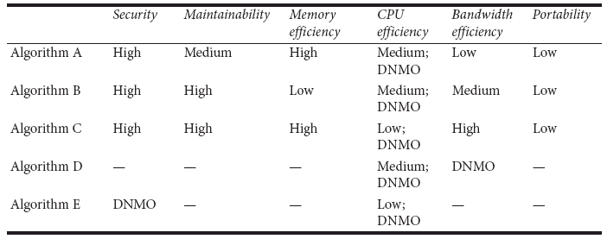
Example evaluation of alternatives
‘DNMO’ means Does Not Meet the Objective

Slide 52
Using cost-benefit analysis to choose among alternatives
  To estimate the costs, add up:
    The incremental cost of doing the software engineering work, including ongoing maintenance
    The incremental costs of any development technology required
    The incremental costs that end-users and product support personnel will experience
  To estimate the benefits, add up:
    The incremental software engineering time saved
    The incremental benefits measured in terms of either increased sales or else financial benefit to users

Slide 53
9.5 Software Architecture
Software architecture is process of designing the global organization of a software system, including:
  Dividing software into subsystems.
  Deciding how these will interact.
  Determining their interfaces.
    The architecture is the core of the design, so all software engineers need to understand it.
    The architecture will often constrain the overall efficiency, reusability and maintainability of the system.

Slide 54
The importance of software architecture
Why you need to develop an architectural model:
  To enable everyone to better understand the system
  To allow people to work on individual pieces of the system in isolation
  To prepare for extension of the system
  To facilitate reuse and reusability

Slide 55
Contents of a good architectural model
A system’s architecture will often be expressed in terms of several different views
  The logical breakdown into subsystems
  The interfaces among the subsystems
  The dynamics of the interaction among components at run time
  The data that will be shared among the subsystems
  The components that will exist at run time, and the machines or devices on which they will be located

Slide 56
Design stable architecture
To ensure the maintainability and reliability of a system, an architectural model must be designed to be stable.
  Being stable means that the new features can be easily added with only small changes to the architecture

Slide 57
Developing an architectural model
Start by sketching an outline of the architecture
  Based on the principal requirements and use cases
  Determine the main components that will be needed
  Choose among the various architectural patterns
    Discussed next
  Suggestion: have several different teams independently develop a first draft of the architecture and merge together the best ideas

Slide 58
Developing an architectural model
  Refine the architecture
    Identify the main ways in which the components will interact and the interfaces between them
    Decide how each piece of data and functionality will be distributed among the various components
    Determine if you can re-use an existing framework, if you can build a framework
  Consider each use case and adjust the architecture to make it realizable
  Mature the architecture

Slide 59
Describing an architecture using UML
  All UML diagrams can be useful to describe aspects of the architectural model
  Four UML diagrams are particularly suitable for architecture modelling:
    Package diagrams
    Subsystem diagrams
    Component diagrams
    Deployment diagrams

Slide 60
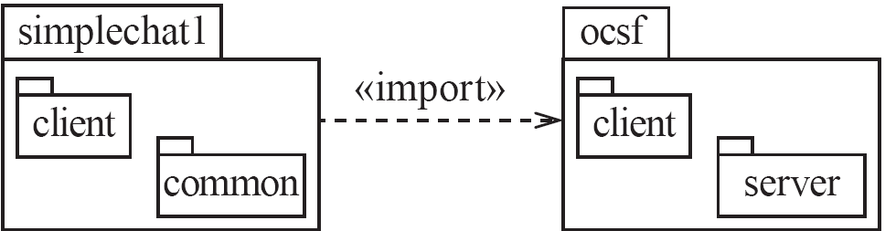
Package diagrams

Slide 61

Component diagrams

Slide 62
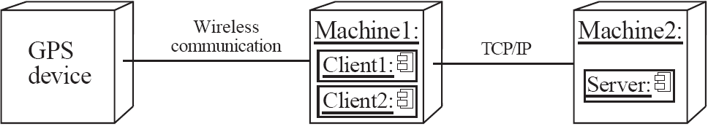
Deployment diagrams

Slide 63
9.6 Architectural Patterns
The notion of patterns can be applied to software architecture.
  These are called architectural patterns or architectural styles.
  Each allows you to design flexible systems using components
    The components are as independent of each other as possible.

Slide 64
The Multi-Layer architectural pattern
In a layered system, each layer communicates only with the layer immediately below it.
  Each layer has a well-defined interface used by the layer immediately above.
    The higher layer sees the lower layer as a set of services.
  A complex system can be built by superposing layers at increasing levels of abstraction.
    It is important to have a separate layer for the UI.
    Layers immediately below the UI layer provide the application functions determined by the use-cases.
    Bottom layers provide general services.
      e.g. network communication, database access

Slide 65
Example of multi-layer systems

Slide 66
The multi-layer architecture and design principles
  1. Divide and conquer: The layers can be independently designed.
  2. Increase cohesion: Well-designed layers have layer cohesion.
  3. Reduce coupling: Well-designed lower layers do not know about the higher layers and the only connection between layers is through the API.
  4. Increase abstraction: you do not need to know the details of how the lower layers are implemented.
  5. Increase reusability: The lower layers can often be designed generically.

Slide 67
The multi-layer architecture and design principles
  6. Increase reuse: You can often reuse layers built by others that provide the services you need.
  7. Increase flexibility: you can add new facilities built on lower-level services, or replace higher-level layers.
  8. Anticipate obsolescence: By isolating components in separate layers, the system becomes more resistant to obsolescence.
  9. Design for portability: All the dependent facilities can be isolated in one of the lower layers.
  10. Design for testability: Layers can be tested independently.
  11. Design defensively: The APIs of layers are natural places to build in rigorous assertion-checking.

Slide 68
The Client-Server and other distributed architectural patterns
  There is at least one component that has the role of server, waiting for and then handling connections.
  There is at least one component that has the role of client, initiating connections in order to obtain some service.
  A further extension is the Peer-to-Peer pattern.
    A system composed of various software components that are distributed over several hosts.

Slide 69
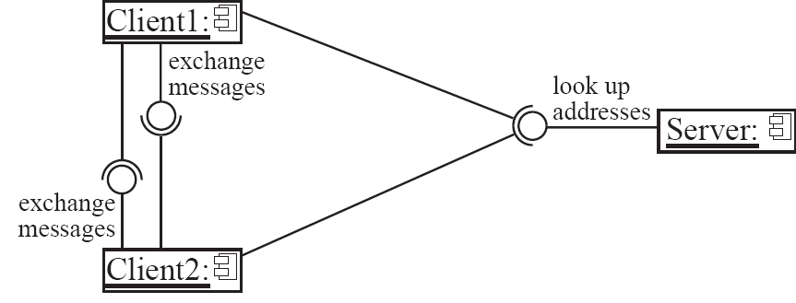
An example of a distributed system

Slide 70
The distributed architecture and design principles
  1. Divide and conquer: Dividing the system into client and server processes is a strong way to divide the system.
    Each can be separately developed.
  2. Increase cohesion: The server can provide a cohesive service to clients.
  3. Reduce coupling: There is usually only one communication channel exchanging simple messages.
  4. Increase abstraction: Separate distributed components are often good abstractions.
  6. Increase reuse: It is often possible to find suitable frameworks on which to build good distributed systems
    However, client-server systems are often very application specific.

Slide 71
The distributed architecture and design principles
  7. Design for flexibility: Distributed systems can often be easily reconfigured by adding extra servers or clients.
  9. Design for portability: You can write clients for new platforms without having to port the server.
  10 Design for testability: You can test clients and servers independently.
  11. Design defensively: You can put rigorous checks in the message handling code.

Slide 72
The Broker architectural pattern
  Transparently distribute aspects of the software system to different nodes
    An object can call methods of another object without knowing that this object is remotely located.
    CORBA is a well-known open standard that allows you to build this kind of architecture.

Slide 73
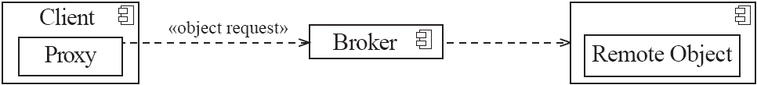
Example of a Broker system

Slide 74
The broker architecture and design principles
  1. Divide and conquer: The remote objects can be independently designed.
  5. Increase reusability: It is often possible to design the remote objects so that other systems can use them too.
  6. Increase reuse: You may be able to reuse remote objects that others have created.
  7. Design for flexibility: The brokers can be updated as required, or the proxy can communicate with a different remote object.
  9. Design for portability: You can write clients for new platforms while still accessing brokers and remote objects on other platforms.
  11. Design defensively: You can provide careful assertion checking in the remote objects.

Slide 75
The Transaction-Processing architectural pattern
A process reads a series of inputs one by one.
  Each input describes a transaction – a command that typically some change to the data stored by the system
  There is a transaction dispatcher component that decides what to do with each transaction
  This dispatches a procedure call or message to one of a series of component that will handle the transaction

Slide 76
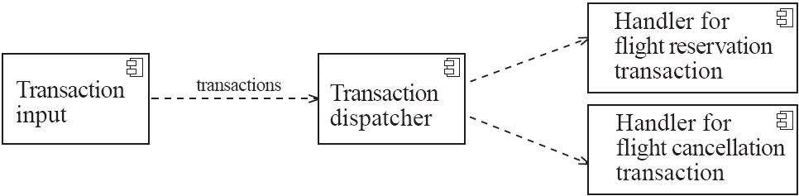
Example of a transaction-processing system

Slide 77
The transaction-processing architecture and design principles
  1. Divide and conquer: The transaction handlers are suitable system divisions that you can give to separate software engineers.
  2. Increase cohesion: Transaction handlers are naturally cohesive units.
  3. Reduce coupling: Separating the dispatcher from the handlers tends to reduce coupling.
  7. Design for flexibility: You can readily add new transaction handlers.
  11. Design defensively: You can add assertion checking in each transaction handler and/or in the dispatcher.

Slide 78
The Pipe-and-Filter architectural pattern
A stream of data, in a relatively simple format, is passed through a series of processes
  Each of which transforms it in some way.
  Data is constantly fed into the pipeline.
  The processes work concurrently.
  The architecture is very flexible.
    Almost all the components could be removed.
    Components could be replaced.
    New components could be inserted.
    Certain components could be reordered.

Slide 79
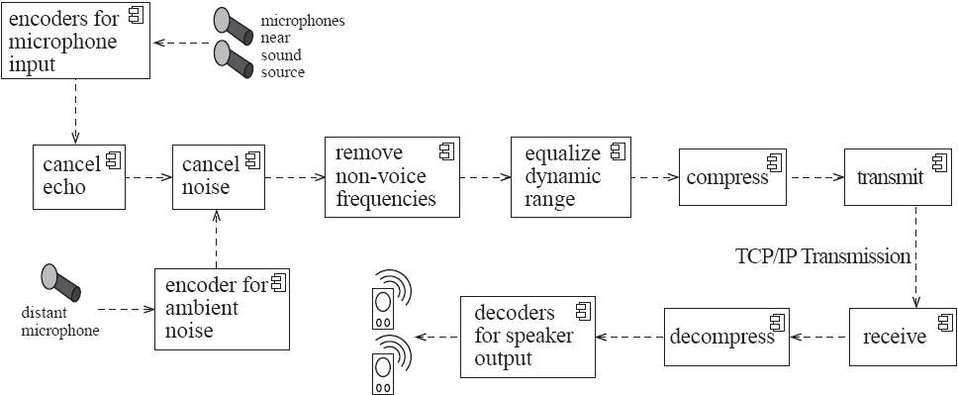
Example of a pipe-and-filter system

Slide 80
The pipe-and-filter architecture and design principles
  1. Divide and conquer: The separate processes can be independently designed.
  2. Increase cohesion: The processes have functional cohesion.
  3. Reduce coupling: The processes have only one input and one output.
  4. Increase abstraction: The pipeline components are often good abstractions, hiding their internal details.
  5. Increase reusability: The processes can often be used in many different contexts.
  6. Increase reuse: It is often possible to find reusable components to insert into a pipeline.

Slide 81
The pipe-and-filter architecture and design principles
  7. Design for flexibility: There are several ways in which the system is flexible.
  10. Design for testability: It is normally easy to test the individual processes.
  11. Design defensively: You rigorously check the inputs of each component, or else you can use design by contract.

Slide 82
The Model-View-Controller (MVC) architectural pattern
An architectural pattern used to help separate the user interface layer from other parts of the system
  The model contains the underlying classes whose instances are to be viewed and manipulated
  The view contains objects used to render the appearance of the data from the model in the user interface
  The controller contains the objects that control and handle the user’s interaction with the view and the model
  The Observable design pattern is normally used to separate the model from the view

Slide 83
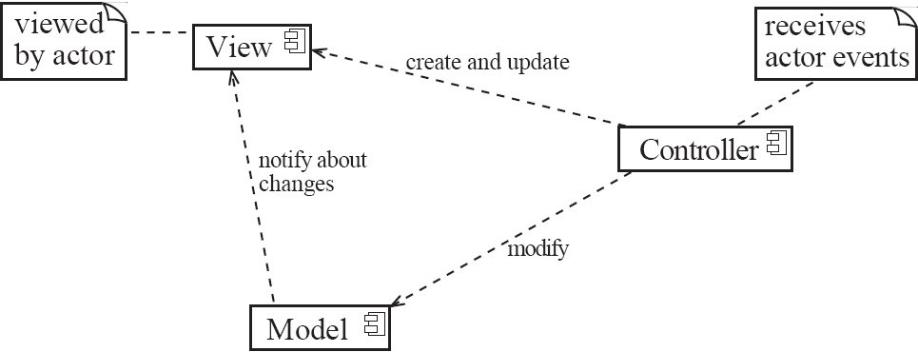
Example of the MVC architecture for the UI

Slide 84
Example of MVC in Web architecture
  The View component generates the HTML code to be displayed by the browser.
  The Controller is the component that interprets ‘HTTP post’ transmissions coming back from the browser.
  The Model is the underlying system that manages the information.

Slide 85
The MVC architecture and design principles
  1. Divide and conquer: The three components can be somewhat independently designed.
  2. Increase cohesion: The components have stronger layer cohesion than if the view and controller were together in a single UI layer.
  3. Reduce coupling: The communication channels between the three components are minimal.
  6. Increase reuse: The view and controller normally make extensive use of reusable components for various kinds of UI controls.
  7. Design for flexibility: It is usually quite easy to change the UI by changing the view, the controller, or both.
  10. Design for testability: You can test the application separately from the UI.

Slide 86
The Service-oriented architectural pattern
This architecture organizes an application as a collection of services that communicates using well-defined interfaces
  In the context of the Internet, the services are called Web services
  A web service is an application, accessible through the Internet, that can be integrated with other services to form a complete system
  The different components generally communicate with each other using open standards such as XML.

Slide 87
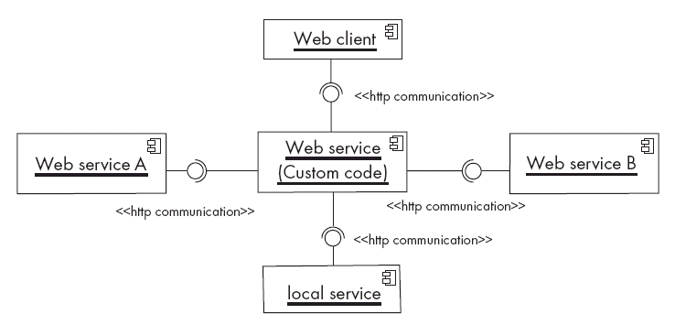
Example of a service-oriented application

Slide 88
The Service-oriented architecture and design principles
  1. Divide and conquer: The application is made of independently designed services.
  2. Increase cohesion: The Web services are structured as layers and generally have good functional cohesion.
  3. Reduce coupling: Web-based applications are loosely coupled built by binding together distributed components.
  5. Increase reusability: A Web service is a highly reusable component.
  6. Increase reuse: Web-based applications are built by reusing existing Web services.
  8. Anticipate obsolescence: Obsolete services can be replaced by new implementation without impacting the applications that use them.

Slide 89
The Service-oriented architecture and design principles
  9. Design for portability: A service can be implemented on any platform that supports the required standards.
  10. Design for testability: Each service can be tested independently.
  11. Design defensively: Web services enforce defensive design since different applications can access the service.

Slide 90
The Message-oriented architectural pattern
Under this architecture, the different sub-systems communicate and collaborate to accomplish some task only by exchanging messages.
  Also known as Message-oriented Middleware (MOM)
  The core of this architecture is an application-to-application messaging system
  Senders and receivers need only to know what are the message formats
  In addition, the communicating applications do not have to be available at the same time (i.e. messages can be made persistent)
  The self-contained messages are sent by one component (the publisher) through virtual channels (topics) to which other interested software components can subscribe (subscribers)

Slide 91
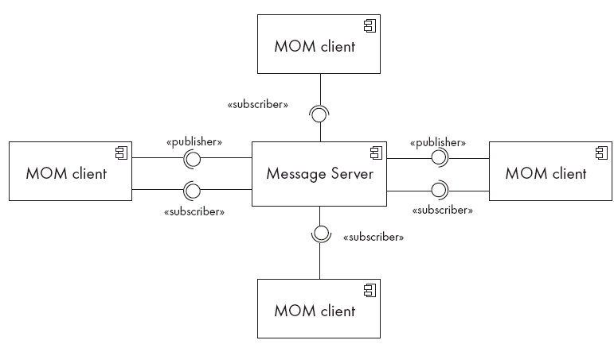
Example of a Message-oriented application

Slide 92
The Message-oriented architecture and design principles
  1. Divide and conquer: The application is made of isolated software components.
  3. Reduce coupling: The components are loosely coupled since they share only data format.
  4. Increase abstraction: The prescribed format of the messages are generally simple to manipulate, all the application details being hidden behind the messaging system.
  5. Increase reusability: A component will be resusable is the message formats are flexible enough.
  6. Increase reuse: The components can be reused as long as the new system adhere to the proposed message formats.

Slide 93
The Message-oriented architecture and design principles
  7. Design for flexibility: The functionality of a message-oriented system can be easily updated or enhanced by adding or replacing components in the system.
  10. Design for testability: Each component can be tested independently.
  11. Design defensively: Defensive design consists simply of validating all received messages before processing them.

Slide 94
Summary of architecture versus design principles
 | 1 | 2 | 3 | 4 | 5 | 6 | 7 | 8 | 9 | 10 | 11
Multi-layers
Client-server
Broker
Transaction processing
Pipe-and-filter
MVC
Service-oriented
Message-oriented

Slide 95
9.7 Writing a Good Design Document
Design documents as an aid to making better designs
  They force you to be explicit and consider the important issues before starting implementation.
  They allow a group of people to review the design and therefore to improve it.
  Design documents as a means of communication.
    To those who will be implementing the design.
    To those who will need, in the future, to modify the design.
    To those who need to create systems or subsystems that interface with the system being designed.

Slide 96
Structure of a design document
  A. Purpose:
    What system or part of the system this design document describes.
    Make reference to the requirements that are being implemented by this design (traceability) .
  B. General priorities:
    Describe the priorities used to guide the design process.
  C. Outline of the design:
    Give a high-level description of the design that allows the reader to quickly get a general feeling for it.
  D. Major design issues:
    Discuss the important issues that had to be resolved.
    Give the possible alternatives that were considered, the final decision and the rationale for the decision.
  E. Other details of the design:
    Give any other details the reader may want to know that have not yet been mentioned.

Slide 97
When writing the document
  Avoid documenting information that would be readily obvious to a skilled programmer or designer.
  Avoid writing details in a design document that would be better placed as comments in the code.
  Avoid writing details that can be extracted automatically from the code, such as the list of public methods.

Slide 98
9.8 Design of a Feature of the SimpleChat System
A. Purpose
  This document describes important aspects of the implementation of the #block, #unblock, #whoiblock and #whoblocksme commands of the SimpleChat system.
B. General Priorities
  Decisions in this document are made based on the following priorities
  (most important first): Maintainability, Usability, Portability, Efficiency
C. Outline of the design
  Blocking information will be maintained in the ConnectionToClient objects. The various commands will update and query the data using setValue and getValue.

Slide 99
Design Example
D. Major design issue
Issue 1: Where should we store information regarding the establishment of blocking?
Option 1.1: Store the information in the ConnectionToClient object associated with the client requesting the block.
Option 1.2: Store the information in the ConnectionToClient object associated with the client that is being blocked.
Decision: Point 2.2 of the specification requires that we be able to block a client even if that client is not logged on. This means that we must choose option 1.1 since no ConnectionToClient will exist for clients that are logged off.

Slide 100
Design Example
E. Details of the design:
Client side:
• The four new commands will be accepted by handleMessageFromClientUI and passed unchanged to the server.
• Responses from the server will be displayed on the UI. There will be no need for handleMessageFromServer to understand that the responses are replies to the commands.

Slide 101
Design Example
Server side:
• Method handleMessageFromClient will interpret #block commands by adding a record of the block in the data associated with the originating client.
  This method will modify the data in response to #unblock.
• The information will be stored by calling setValue("blockedUsers", arg)
  where arg is a Vector containing the names of the blocked users.
• Method handleMessageFromServerUI will also have to have an implementation of #block and #unblock.
  These will have to save the blocked users as elements of a new instance variable declared thus: Vector blockedUsers;

Slide 102
Design Example
• The implementations of #whoiblock in handleMessageFromClient and handleMessageFromServerUI will straightforwardly process the contents of the vectors.
• For #whoblocksme, a new method will be created in the server class that will be called by both handleMessageFromClient and handleMessageFromServerUI.
  This will take a single argument (the name of the initiating client, or else 'SERVER').
  It will check all the blockedUsers vectors of the connected clients and also the blockedUsers instance variable for matching clients.

Slide 103
Design example
• The #forward, #msg and #private commands will be modified as needed to reflect the specifications.
  Each of these will each examine the relevant blockedUsers vectors and take appropriate action.

Slide 104
9.9 Difficulties and Risks in Design
Like modelling, design is a skill that requires considerable experience
    Individual software engineers should not attempt the design of large systems
    Aspiring software architects should actively study designs of other systems
Poor designs can lead to expensive maintenance
    Ensure you follow the principles discussed in this chapter

Slide 105
Difficulties and Risks in Design
It requires constant effort to ensure a software system’s design remains good throughout its life
    Make the original design as flexible as possible so as to anticipate changes and extensions.
    Ensure that the design documentation is usable and at the correct level of detail
    Ensure that change is carefully managed

